Slide 1
WHO guidelines & operational handbook:
Module 1:
Tuberculosis preventive treatment

Slide 2
Overview of guidelines
18 recommendations on 4 critical steps of the TB preventive care pathway:
Identify people at risk
Rule out TB disease
Test for TB infection
Options for TPT regimens
(Research gaps)
2020
https://extranet.who.int/tbknowledge/node/2

Slide 3
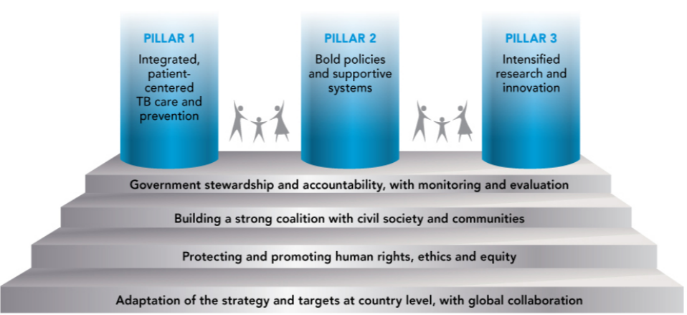
Background (1)
The End TB Strategy – Pillars 1 & 2
TB preventive treatment (TPT) fits within a larger framework of preventive actions envisaged by Pillars 1 and 2 of the End TB Strategy, ranging from active TB case finding, infection control, prevention and care of HIV and other co-morbidities and health risks, access to universal health care, social protection and poverty alleviation.

Slide 4
Background (2)
The potential of TPT to accelerate the decline in TB incidence
Baseline
1000
Mitigate risk factors
Prevent infection
100
Treat TB disease
TB incidence (cases per million pop. per year)
Treat TB infection
10
End TB Strategy : -90% by 2035
Treat TB disease
and infection
2000
2010
2020
2030
2040
2050
From Dye C et al., Prospects for Tuberculosis Elimination. Ann Rev Public Health 2013. 34:271-86
Notes:
This slide from a study performed ahead of the launch of the End TB Strategy models the expected impact of different interventions for TB. It shows that only an approach that combines the treatment of both TB disease and TB infection at large scale would be expected to bring down the TB incidence to the levels envisaged by the End TB Strategy by 2035.

Slide 5
Evidence (1): TPT for people living with HIV
Adults and adolescents living with HIV (Pre-ART)
In a systematic review of 12 RCTs (8578 people living with HIV), isoniazid preventive treatment reduced overall risk for TB by 33% (relative risk 0.67, 95% CI: 0.51–0.87)
TST positive, the reduction increased to 64% (RR 0.36, 95% CI 0.22–0.61)
TST negative, 14% (RR 0.86, 95% CI 0.59–1.26)
Adults and adolescents living with HIV (ART)
In one RCT (2056 people living with HIV), isoniazid preventive treatment showed additive benefits to ART in reducing both TB incidence and overall mortality
In one double-blind RCT (1329 people living with HIV receiving ART), the effect of isoniazid preventive treatment was not statistically significantly different between patients who were positive or negative on TST or IGRA
Children and infants with HIV
Overall limited or low-quality evidence in children with HIV, but Guideline Development Groups deemed it biologically plausible to extrapolate evidence from adults with HIV with and without ART to children
Notes:
1.Akolo C, Adetifa I, Shepperd S, Volmink J. Treatment of latent tuberculosis infection in HIV infected persons. Cochrane Database of Systematic Reviews [Internet]. 2010 Jan 20 [cited 2022 Mar 16];(1). Available from: https://www.cochranelibrary.com/cdsr/doi/10.1002/14651858.CD000171.pub3/ful
2.Rangaka MX, Wilkinson RJ, Boulle A, Glynn JR, Fielding K, Van Cutsem G, et al. Isoniazid plus antiretroviral therapy to prevent tuberculosis: A randomised double-blind, placebo-controlled trial. The Lancet [Internet]. 2014 Aug 23 [cited 2022 Feb 11];384(9944):682–90. Available from: http://www.thelancet.com/article/S0140673614601628/fulltext
3.Badje A, Moh R, Gabillard D, Guéhi C, Kabran M, Ntakpé JB, et al. Effect of isoniazid preventive therapy on risk of death in west African, HIV-infected adults with high CD4 cell counts: long-term follow-up of the Temprano ANRS 12136 trial. Lancet Glob Health [Internet]. 2017 Nov 1 [cited 2022 Feb 11];5(11):e1080–9. Available from: https://europepmc.org/article/med/29025631
4.The TASG. A Trial of Early Antiretrovirals and Isoniazid Preventive Therapy in Africa. New England Journal of Medicine. 2015;373(9):808-22.

Slide 6
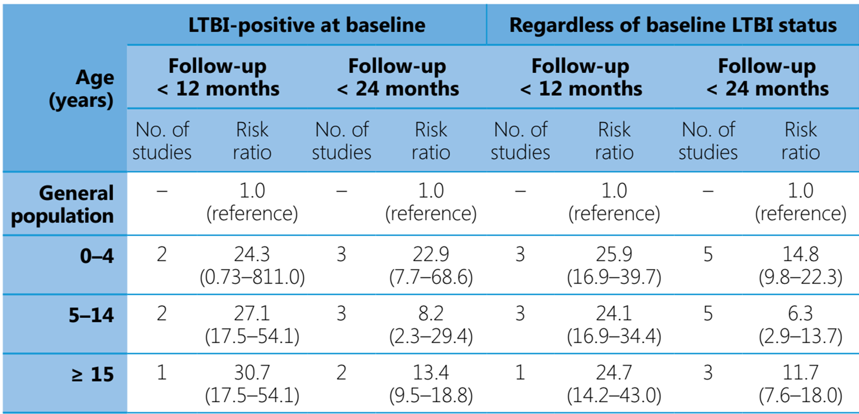
Evidence (2): TPT for household contacts Risk for TB in household contacts by age-group and baseline infection status, compared with the general population

Slide 7
Evidence (3): TPT options
Daily rifampicin plus isoniazid for 3 months (3HR)
A systematic review updated in 2017 showed that the efficacy and the safety profile of 3–4 months daily rifampicin plus isoniazid were similar to those of 6 months daily isoniazid
Daily rifampicin monotherapy for 4 months (4R)
A systematic review conducted for the 2015 TPT guidelines and updated in 2017 showed
similar efficacy for 3–4 months daily rifampicin and 6 months daily isoniazid (OR, 0.78; 95% CI, 0.41–1.46)
individuals given rifampicin daily for 3–4 months had a lower risk for hepatotoxicity than those treated with isoniazid monotherapy (OR 0.03; 95% CI 0.00–0.48)
in individuals <18 years, the difference in rate of TB disease between 4R and 9H (4R arm minus 9H arm) was -0.37 cases per 100 person-years (95% CI, −0.88; 0.14), while in individuals >17 years, the difference was <0.01 cases cases per 100 person-years (95%CI, −0.14;–0.16)
Notes:
1.Zenner D, Beer N, Harris RJ, Lipman MC, Stagg HR, van der Werf MJ. Treatment of Latent Tuberculosis Infection: An Updated Network Meta-analysis. Ann Intern Med. 2017;167(4):248-55.
2.Stagg HR, Zenner D, Harris RJ, Muñoz L, Lipman MC, Abubakar I. Treatment of latent tuberculosis infection: a network meta-analysis. Ann Intern Med. 2014;161(6):419-28.
3.Diallo T, Adjobimey M, Ruslami R, Trajman A, Sow O, Obeng Baah J, et al. Safety and Side Effects of Rifampin versus Isoniazid in Children. N Engl J Med. 2018;379(5):454-63.
4.Menzies D, Dion MJ, Rabinovitch B, Mannix S, Brassard P, Schwartzman K. Treatment completion and costs of a randomized trial of rifampin for 4 months versus isoniazid for 9 months. Am J Respir Crit Care Med. 2004;170(4):445-9.
5.Menzies D, Long R, Trajman A, Dion MJ, Yang J, Al Jahdali H, et al. Adverse events with 4 months of rifampin therapy or 9 months of isoniazid therapy for latent tuberculosis infection: a randomized trial. Ann Intern Med. 2008;149(10):689-97.

Slide 8
Evidence (4): TPT options
Daily rifapentine plus isoniazid for one month (1HP)
In one multi-country RCT, among all study participants, the difference in incidence rate of TB between 1HP and 9H (i.e., 1HP arm minus 9H arm) was −0.02 per 100 person-years (95% confidence interval [CI], −0.35; +0.30)
Non-inferiority was also shown for the sub-group with confirmed TB infection (incidence rate difference per 100 person-years = 0.069 [-0.830 to 0.690]), and among those on or without ART at start of study.
Weekly rifapentine plus isoniazid for 3 months (3HP)
A systematic review was conducted for the 2018 guidelines update to compare effectiveness of 3HP with that of isoniazid monotherapy (4 RCTs).
No significant difference found in incidence of TB disease between 3HP and 6H or 9H (RR 0.73, 95% CI 0.23; 2.30)
3HP associated with higher completion in all subgroups (adults with HIV: RR 1.25, 95% CI 1.01; 1.55).
Notes:
1.Swindells S, Ramchandani R, Gupta A, Benson CA, Leon-Cruz J, Mwelase N, et al. One Month of Rifapentine plus Isoniazid to Prevent HIV-Related Tuberculosis. N Engl J Med. 2019;380(11):1001-11.
2.Martinson NA, Barnes GL, Moulton LH, Msandiwa R, Hausler H, Ram M, et al. New regimens to prevent tuberculosis in adults with HIV infection. N Engl J Med. 2011;365(1):11-20.
3.Sterling TR, Villarino ME, Borisov AS, Shang N, Gordin F, Bliven-Sizemore E, et al. Three months of rifapentine and isoniazid for latent tuberculosis infection. N Engl J Med. 2011;365(23):2155-66.
4.Sterling TR, Scott NA, Miro JM, Calvet G, La Rosa A, Infante R, et al. Three months of weekly rifapentine and isoniazid for treatment of Mycobacterium tuberculosis infection in HIV-coinfected persons. AIDS. 2016;30(10):1607-15.
5.Villarino ME, Scott NA, Weis SE, Weiner M, Conde MB, Jones B, et al. Treatment for preventing tuberculosis in children and adolescents: a randomized clinical trial of a 3-month, 12-dose regimen of a combination of rifapentine and isoniazid. JAMA Pediatr. 2015;169(3):247-55.

Slide 9
Recommendations (1) Identify people at risk
People living with HIV
Adults and adolescents (>10y) [regardless of ARV, pregnancy, previous TB treatment, immunosuppression and availability of test for TB infection]*
Infants aged < 12 months who are in contact with TB*
Children aged ≥ 12 months in a high TB transmission setting
All children who successfully completed treatment for TB disease
Household contacts of pulmonary TB (bacteriologically confirmed)
Children < 5 years*
Individuals aged ≥ 5 years
Exposed to multidrug-resistant tuberculosis
Other risk indicating systematic testing & TPT
People who have silicosis, or who are initiating anti-TNF treatment or dialysis, or preparing for an organ or haematological transplant*
Prisoners, health workers, immigrants from countries with a high TB burden, homeless people and people who use drugs
No systematic testing & treatment in diabetes, harmful use of alcohol, tobacco smoking, underweight
* Strong recommendation

Slide 10
Recommendations (2) Rule out TB disease
People living with HIV
Adults and adolescents (>10 y) without current cough, fever, weight loss or night sweats are unlikely to have TB disease*
Chest radiography may be offered to people with HIV on ART and TPT given to those without abnormal radiographic findings
Adults and adolescents with any of current cough, fever, weight loss or night sweats should be evaluated for TB and other diseases*
Infants and children (<10 y) who have poor weight gain, fever or current cough or who have a history of contact with a person with TB should also be evaluated for TB and other diseases*
Household contacts of pulmonary TB
The absence of any symptoms of TB and the absence of abnormal chest radiographic findings may be used to rule out active TB disease among HIV-negative household contacts aged ≥ 5 years and other risk groups before preventive treatment
* Strong recommendation

Slide 11
Recommendations (3) Tests for TB infection
Either a TST or IGRA can be used to test for TB infection*
New antigen-based skin tests for TB infection since 2022
A test for TB infection is not a requirement for initiating TPT in people with HIV or individuals aged < 5 years in contact with people with TB disease*
* Strong recommendation

Slide 12
Recommendations (4) TPT options
6 or 9-month, daily isoniazid*
3-month, weekly isoniazid and rifapentine*
3-month, daily isoniazid and rifampicin*
1-month, daily isoniazid and rifapentine
4-month, daily rifampicin
36-month, daily isoniazid in people with HIV >10y in settings with high TB transmission
6-month, daily levofloxacin +/- other drugs (exposure to MDR/RR-TB)
* Strong recommendation

Slide 13
Operational handbook
2020
Provides complementary details on TPT critical to the implementation of different elements of PMTPT e.g., contact evaluation, drug dosages, safety monitoring, programme indicators
https://extranet.who.int/tbknowledge/node/619

Slide 14
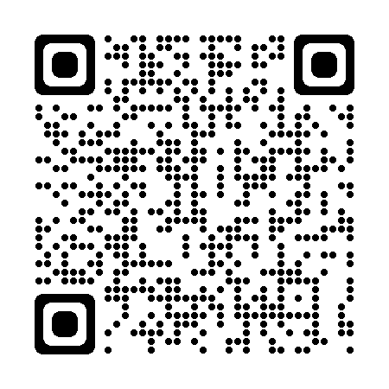
Operational handbook (1)​
How protective is TPT?
Efficacy of isoniazid preventive treatment ranges from 60-90%
1960s, Alaskan natives: IPT reduced TB incidence by about 55% over 6 years
1993-2007, various countries (Cochrane Review of 12 trials): TPT in people with HIV reduced risk of active TB by about one third. IPT and HR reduced mortality in people with HIV.
2003-2009, Brazil: 6H in TST+ people with HIV reduced TB risk for at least 7 years
2005+, SA gold mines: among HIV+ miners (high transmission / reinfection) TB incidence reduced by 58% while on 9H but risk quickly returned after stopping
2008-2015, Côte d’Ivoire: 6H reduced mortality by 37% (independent of ART and baseline CD4) and benefits sustained for at least 6 years after randomization
Notes:
While the protective effect of IPT has been observed to last unaltered for several years, its efficacy is generally estimated to range from 60-90%. Over the years, other studies have shown substantive reduction in TB incidence and death in different populations on IPT and other TPT regimens, including PLHIV in high TB transmission settings
References
Hanson, ML; Comstock, GW; Haley, CE (1967). Community isoniazid prophylaxis program in an underdeveloped area of Alaska. https://dx.doi.org/10.2307/4593193
Comstock GW, Baum C, Snider DE Jr. Isoniazid prophylaxis among Alaskan Eskimos: a final report of the Bethel isoniazid studies. Am Rev Respir Dis 1979; 119:827–30
Golub JE, Cohn S, Saraceni V, et al. Long-term protection from isoniazid preventive therapy for tuberculosis in HIV-infected patients in a medium-burden tuberculosis setting: the TB/HIV in Rio (THRio) study. Clin Infect Dis. 2014;60(4):639-45.
Akolo C, Adetifa I, Shepperd S, Volmink J. Treatment of latent tuberculosis infection in HIV infected persons. Cochrane Database Syst Rev 2010; CD000171.
Anani Badje et.al. Effect of isoniazid preventive therapy on risk of death in west African, HIV-infected adults with high CD4 cell counts: long-term follow-up of the Temprano ANRS 12136 trial
Churchyard GJ et.al. A Trial of Mass Isoniazid Preventive Therapy for Tuberculosis Control; Jan 2014; NEJM; 2014; 370:301-310; DOI: 10.1056/NEJMoa1214289 (https://www.nejm.org/doi/full/10.1056/NEJMoa1214289)

Slide 15
Operational handbook (2)​
Do we need to repeat or restart TPT?
No evidence to date on the utility of repeated courses of TPT
A repeat course of TPT may be considered among people with or without HIV following a fresh exposure to an infectious TB patient based on clinical judgement
In high TB transmission settings, WHO recommends 36 H (proxy for life long) for people with HIV
The WHIP3TB trial among people with HIV on ART (2019), compared the effectiveness of 3HP given once (N=1802) or twice within 14 months (N=1808) as against one course of 6H (N=404)
Treatment completion was better with 3HP
24 months follow-up showed similar rates of incidence of TB, rifampicin-resistant TB and mortality between those receiving 3HP once or twice

Slide 16
Operational handbook (3)​
Is it safe to give TPT?
In general, TPT is safe and shorter regimens make it more tolerable
A systematic review of 23 RCTs & 55 non-randomised studies found that
Hepatotoxicity: 3HP (1%), 3-4R (0.01%), 6H(6.3%), 9H (3.1%)
Withdrawals due to AEs: 3HP (1.7%) vs 9H (6.4%), 6H (3.8%)
Rate of any AE: 3HP (11.5%), 3-4R (20%), 6H (36.1%), 9H (17.6%)
Flu like reactions: 3HP (2.2%) vs INH (0.05%)
Notes:
REF: Pease C, Hutton B, Yazdi F, Wolfe D, Hamel C, Barbeau P, Skidmore B, Alvarez GG. A systematic review of adverse events of rifapentine and isoniazid compared to other treatments for latent tuberculosis infection. Pharmacoepidemiol Drug Saf. 2018 Jun;27(6):557-566. doi: 10.1002/pds.4423. Epub 2018 Mar 23. PMID: 29573031.

Slide 17
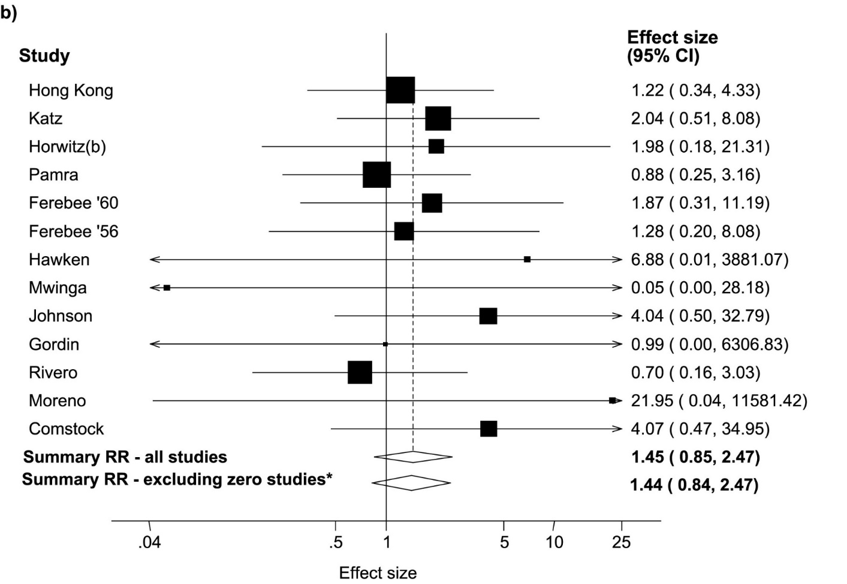
Operational handbook (4)​
Does TPT fuel emergence of drug resistance?
Systematic review (den Boon S et al; 2016):
6 RCTs of rifamycin based TPT vs active control or placebo
Only 6 (0.09%) rifampicin resistant cases in 6808 individuals receiving rifamycin based TPT
1 (0.01%) rifampicin resistant case among 7415 individuals receiving alternative regimens
RR = 3.45, (95%CI 0.72–16.56; P = 0.12)
3 studies of intermittent rifamycin based TPT vs active control or placebo
3 cases of rifampicin resistance in 4673 individuals on rifamycin-containing TPT regimens
1 case with rifampicin resistance in 4427 in control regimens
Systematic review (Balcells ME et al; 2006):
data published since 1951, 13 studies, IPT = 18095, controls = 17,985
RR of resistance 1.45 (95% CI 0.85 – 2.47)
Similar results when stratified by HIV
Notes:
den Boon S, Matteelli A, Getahun H. Rifampicin resistance after treatment for latent tuberculous infection: a systematic review and meta-analysis. Int J Tuberc Lung Dis. 2016 Aug;20(8):1065-71. doi: 10.5588/ijtld.15.0908. PMID: 27393541; PMCID: PMC5642842.
Balcells M E, Thomas S L, Godfrey-Faussett P, Grant A D. Isoniazid preventive therapy and risk for resistant tuberculosis. Emerging Infectious Diseases 2006; 12(5): 744-751

Slide 18
Operational handbook (5)​
Is TPT recommended in pregnancy?
Systematic review for the 2020 WHO guidelines showed
No association of IPT with adverse pregnancy outcomes (foetal or neonatal death, prematurity, low birth weight, congenital anomaly) across different studies
No increase in risks for maternal hepatotoxicity, grade 3 or 4 events or death
Therefore,
Pregnancy does not disqualify women living with HIV from TPT or require systematic deferral of TPT to the postpartum period
TPT can be started either in the antenatal and postnatal periods with due clinical care
Vitamin B6 supplementation should be given routinely to pregnant and breastfeeding women on TPT
6 months triple pill combination of H + Cotrimoxazole + B6 may be preferred in pregnant women with HIV
Routine liver function testing is not indicated unless there are other hazards

Slide 19
Operational handbook (6)​
How to manage TPT interruptions?
Add missing doses at the end if
>80% of total doses were taken during expected time
regimen can be completed in 133% of expected duration
If the two conditions are not satisfied, restart TPT
Regimen | Doses |  | 133% of expected duration (days)
 | Expected | 80% of expected
6H | 182 | 146 | 239
4R | 120 | 96 | 160
3HR | 84 | 68 | 120
3HP | 12 | 10 | 120
1HP | 28 | 23 | 37
Notes:
Programmes should promote the completion of all prescribed doses of TB preventive treatment within the expected duration. There is limited evidence to inform the management of treatment interruption or prescribing how many missed doses can be made up for by prolonging treatment without compromising efficacy. However, two main considerations are advised when deciding whether to prolong a course of TPT, to restart it afresh or to offer an alternative regimen, following an interruption. Firstly, the number of doses taken during the time the regimen was expected to last and secondly the maximal prolongation needed to allow the missed doses to be completed. When less than 80% of expected doses were taken in the time expected for the regimen to be completed, the treatment duration can be extended by the number of daily doses missed. However, if less than 80% of doses were taken and treatment cannot be completed within 133% of the expected time for completion, restarting treatment should be considered. For 3HP, treatment only needs to be restarted when more than 3 doses have been missed.

Slide 20
Operational handbook (7)​
Which elements to record for the monitoring of TPT activities?
How many people are at risk and could benefit from TPT ?
How many of those at risk were evaluated for TB disease or infection ?
How many of those eligible for TPT initiated treatment ?
For those eligible who did not initiate TPT what were the main reasons ?
How many of those initiating TPT completed it ?
For those who did not complete TPT what were the main reasons (e.g., adverse drug reaction monitoring and management) ?
Notes:
Programmes should promote the completion of all prescribed doses of TB preventive treatment within the expected duration. There is limited evidence to inform the management of treatment interruption or prescribing how many missed doses can be made up for by prolonging treatment without compromising efficacy. However, two main considerations are advised when deciding whether to prolong a course of TPT, to restart it afresh or to offer an alternative regimen, following an interruption. Firstly, the number of doses taken during the time the regimen was expected to last and secondly the maximal prolongation needed to allow the missed doses to be completed. When less than 80% of expected doses were taken in the time expected for the regimen to be completed, the treatment duration can be extended by the number of daily doses missed. However, if less than 80% of doses were taken and treatment cannot be completed within 133% of the expected time for completion, restarting treatment should be considered. For 3HP, treatment only needs to be restarted when more than 3 doses have been missed.

Slide 21
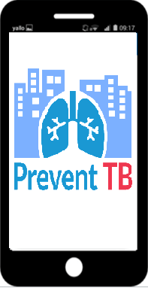
https://www.who.int/activities/preventing-tb/
Notes:
The Prevent TB app facilitates the management of data and monitoring of progress on TB preventive treatment and active TB case finding among contacts and other people at risk. The app is free to download from iOS and Android and can be installed on smartphones and tablet computers. The app can be customized via a set-up site and the indicators can be displayed in tabular or graphic form via a dashboard output

Slide 22
Main messages
TPT is effective and safe. There is no evidence that it favours the emergence of drug resistance
TPT complements other preventive measures and active TB case finding
There is a need to expand TPT coverage for people at risk, including household contacts aged 5 years and older
Chest X-ray can rule out TB more effectively and new tools make this more feasible, particularly digital radiography and computer-aided detection
Antigen-based tests will facilitate testing for TB infection
Different TPT regimens offer more choice, including shorter ones that are safer and easier to complete
New tools for capacity building and monitoring and evaluation are available

Slide 23
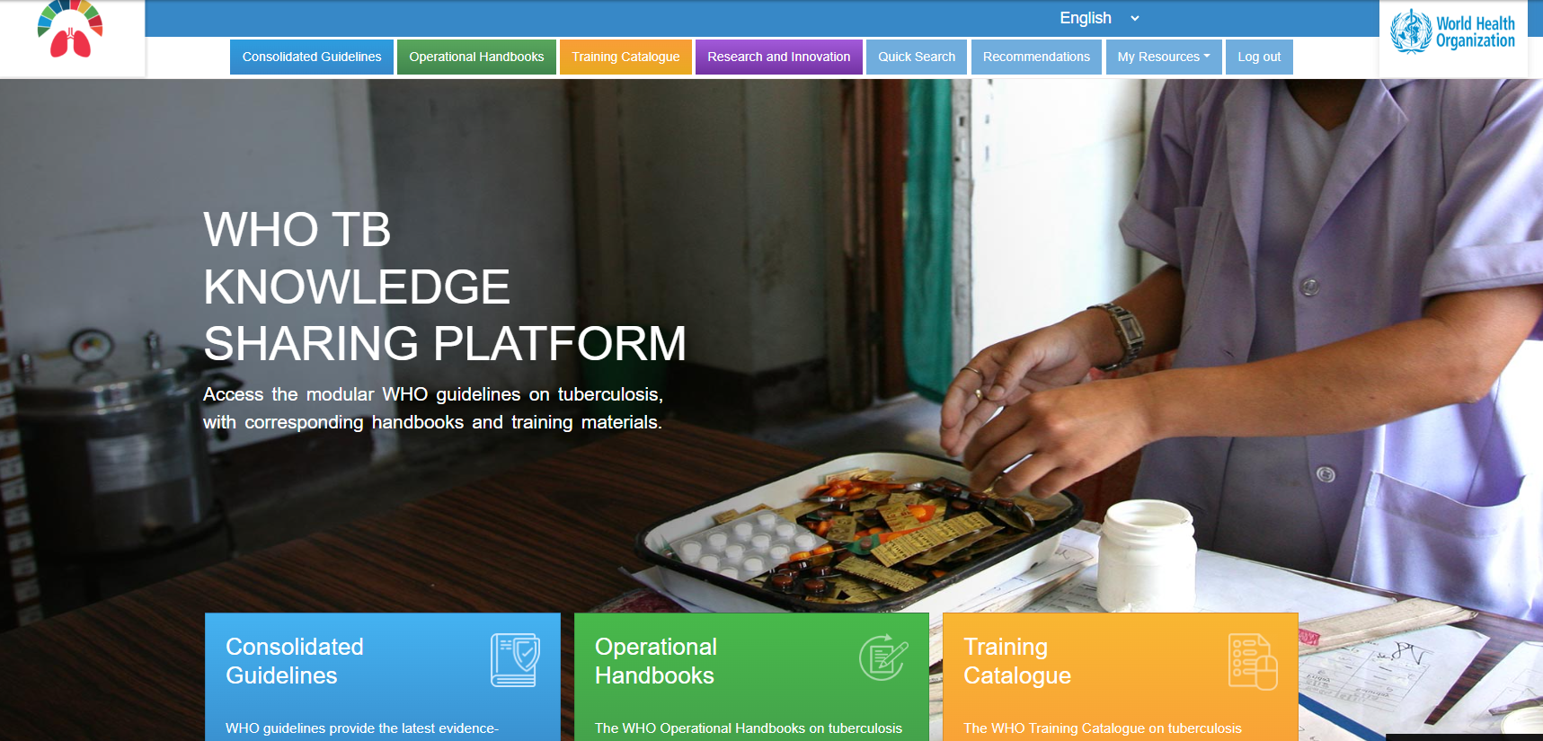
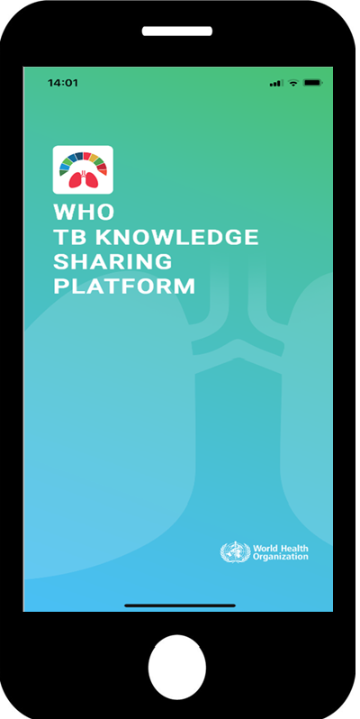
https://extranet.who.int/tbknowledge

Slide 24
Acknowledgement
WHO Global TB Programme (Dennis Falzon, Avinash Kanchar)​
Other WHO staff at HQ, Regions and Country offices​
Guideline Development Group & other experts (see https://tbksp.org/en/node/25)​
Staff of national TB programmes in Member States
Treatment Action Group
USAID, Unitaid, The Global Fund
Many other experts, donors

Slide 25
© WORLD HEALTH ORGANIZATION 2023
All rights reserved. Publications of the World Health Organization can be obtained from WHO Press, World Health Organization, 20 Avenue Appia, 1211 Geneva 27, Switzerland (tel: +41 22 791 3264; fax: +41 22 791 4857; email: bookorders@who.int). Requests for permission to reproduce or translate WHO publications – whether for sale or for noncommercial distribution – should be addressed to WHO Press, at the above address (fax: +41 22 791 4806; email: permissions@who.int).
The designations employed and the presentation of the material in this publication do not imply the expression of any opinion whatsoever on the part of the World Health Organization concerning the legal status of any country, territory, city or area or of its authorities, or concerning the delimitation of its frontiers or boundaries. Dotted lines on maps represent approximate border lines for which there may not yet be full agreement.
The mention of specific companies or of certain manufacturers’ products does not imply that they are endorsed or recommended by the World Health Organization in preference to others of a similar nature that are not mentioned. Errors and omissions excepted, the names of proprietary products are distinguished by initial capital letters.
All reasonable precautions have been taken by the World Health Organization to verify the information contained in this publication. However, the published material is being distributed without warranty of any kind, either expressed or implied. The responsibility for the interpretation and use of the material lies with the reader. In no event shall the World Health Organization be liable for damages arising from its use.

